Slide 1
Open cover
Functional Test coverage Tool

Slide 2


Functional TEST Coverage Tools & Why Open Cover
 | Ncover | DotCover | Coverlet | Open Cover
License Type | Commerical | Commerical | Free/Open Source | Free/Open Source
.NET 4.5.2 or Above
.NET Core
Support IIS & IIS Express

Slide 3
Benefits of open cover - functional test coverage
Easy To Use – Two steps process to run functional test coverage
Step One - Run Open Cover
Step Two – Generate Report
No modification needed to existing project.
It can runs as standalone application without installing nugget packages
Supports
.NET ASPX, MVC, Console and .NET CORE Projects
*Support multiple sites run with in two steps process(Should have .NET 4.7.2 Framework installed on machine)
Using Reports we can find out business scenario that are not covered as well as dead code

Slide 4
Open Cover & Report generator Versions
Open Cover is a Functional Test Coverage tool for .NET
https://github.com/OpenCover/opencover
Report generator
https://github.com/danielpalme/ReportGenerator
.NET 4.5.2 | https://github.com/OpenCover/opencover/releases/download/4.5.3427/opencover.4.5.3427.zip
.NET 4.7 | https://github.com/OpenCover/opencover/releases/download/4.7.922/opencover.4.7.922.zip
.NET 4.5.2 | https://github.com/danielpalme/ReportGenerator/releases/download/v3.1.2.0/ReportGenerator_3.1.2.0.zip
.NET 4.7 | https://github.com/danielpalme/ReportGenerator/releases/download/v4.2.5/ReportGenerator_4.2.5.zip

Slide 5
Open Cover & Report generator – prerequisite
Prerequisite:
CPU 2GHZ or above, RAM 8GB or above
.NET 4.5.2 Framework or above
IIS Express With 32 Bit/64 Bit

Slide 6
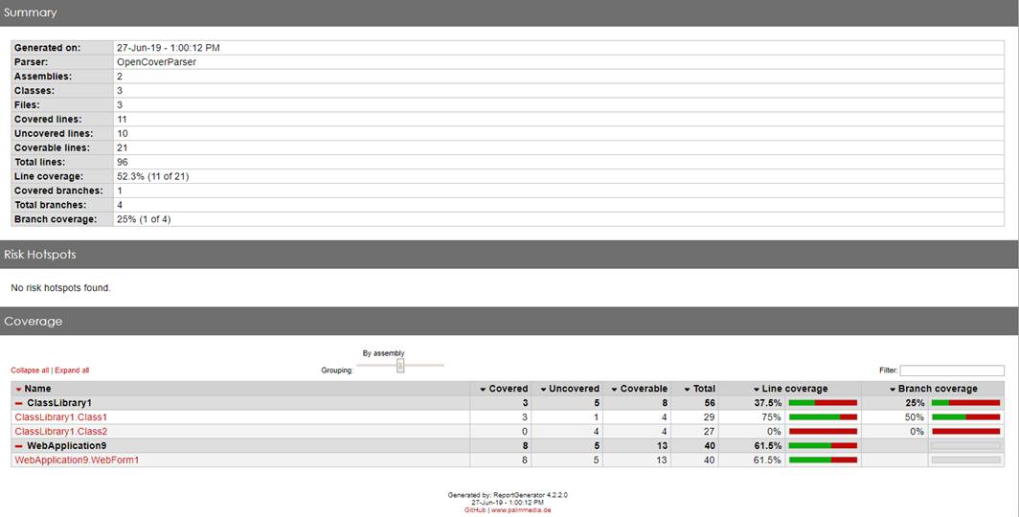
Demo

Slide 7
Thank You

